Slide 1
Part 2: Organising Nodes and Coding Cases in NVivo
Alex Shermon | Research Computing Services

Slide 2
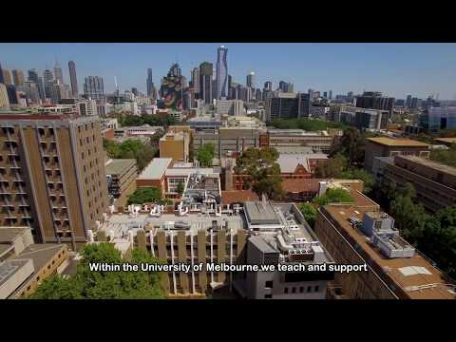
Welcome to Research Computing Services!

Slide 3
Digital Support Packs
During this time, we’ve moved our face to face training online.
Our trainings are now shorter, and are accompanied with an online learning lab.
This lab will help guide you through today’s training, and contains extra resources to help you learn NVivo!

Slide 4
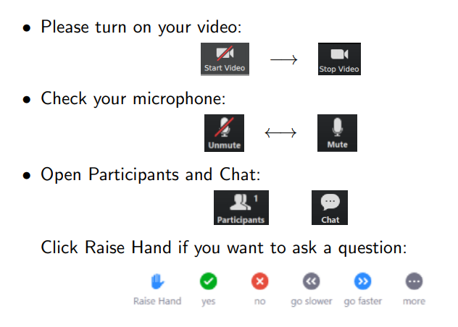
Zoom Etiquette

Slide 5
About Me
Masters of Global Media Communications Student
Omeka and NVivo Research Community Coordinator
Research Assistant on some neat archival projects
Playing SO MUCH Dungeons and Dragons right now

Slide 6
Today’s Learning Objectives
This workshop will teach you the basics of how NVivo can assist you in qualitative and mixed-methods research
By the end of this workshop you will understand how to:
Organise your coding
Create case classifications
Code for cases and assign them to classifications

Slide 7
Organising your Coding

Slide 8
The State of our Research Project
In Part 1, I:
Imported interview transcripts into NVivo
Began to code those interviews to answer the research question: what do these interviewees have to say about the water system in their local area and does this differ across demographic attributes?
Today, I want to
Critically evaluate and organise my nodes
Categorise my interviewees as people
Assign them demographic attributes

Slide 9
Managing your Nodes
Managing nodes is critical NVivo - it is part of the research process.
You can:
Move nodes under existing nodes
Out of existing nodes
Create folders for them.

Slide 10
For our Research Project
Let’s say we have two nodes: “Water Quality”, and “Landscape Features”.
As I continue my research, I realise that these two nodes are not distinct, and I want to place them under a larger, parent node - “The Environment” - to help to organise my research data.
I also want to rename my “Landscape Features” node to a more easier to grasp “Landscape” node

Slide 11
Demo: Node Management
I’ll show you how to create folders for nodes and how to move nodes around.

Slide 12
Challenge: Organising your Nodes
Create a node underneath an existing node
Rename an existing node
Drag nodes to reorganise them

Slide 13
2. Case Classifications

Slide 14
Cases and Case Classifications
THIS PART IS QUITE TRICKY
I’m still working out how to properly explain these concepts
Refer to the GitBook site for extra help with cases and classifications

Slide 15
What are Case Classifications?
Case Classifications are the broad categories which you can assign to elements of your research (people, institutions, organisations)
Cases are instances of those categories, or “units of observation” within your data. An example of a case might be a specific person like Barbara.

Slide 16
Case Classifications and Attributes
Attributes are subcategories within your classification that are designed to help you answer your research question.
Examples of attributes are things like:
Age
Occupation

Slide 17
Our Workflow Today
Creating a Case Classification
Creating Attributes for that Classification
Creating Cases within our data
Telling NVivo that our Cases belong to a classification
Assigning values to our case through the attributes in the classification
There are OTHER ways to do cases and classifications, and you’ll find it a lot easier once you’ve had a play around and an experiment!

Slide 18
For our Research Project
I’ve done some thematic analysis, and I know from other research I read during my literature review, that different themes will appear more prevalently, or differently, depending on the demographic attributes of my interviewees.
So, I need to begin the process of letting NVivo know who my interviewees are, and where they are within my research data.
Firstly then, I need to create a container (a classification) to include all of my demographic information.

Slide 19
Challenge: Create a Case Classification
Navigate to the case classifications tab on the left
Create a new case classification for “People” or “Person”
Once you’ve created the classification, create several general attributes for it such as “Age” or “Occupation”
Bonus: You can also create lists of potential attribute values, which means you can assign values from a list when describing your cases

Slide 20
3. Cases

Slide 21
Understanding Cases
Our next step: Telling NVivo that data in our project belongs to a case
This process is VERY SIMILAR to coding nodes (Module 1)
Whilst our nodes were themes like “economy” or “environment”, our cases will instead be units of observation like “Barbara”, or “The University of Melbourne”
We create cases the same way as we do themes, by dragging data over from our text into the cases folder

Slide 22
Assigning Classifications and Attributes
The “Case properties” window is the best way to assign a classification to a case.
Once you’ve done that, you can easily assign attribute values in the fields that pop up (like a spreadsheet)

Slide 23
For our Research Project
In the last step, I created a classification for the people in my research project.
Now, I need to tell NVivo that they belong to that classification.
Once I’ve done that, I can then fill in values for the demographic attributes that I previously created.
Once I’ve done that, I can then move on to visualising comparisons between themes across these demographic values that I have created.

Slide 24
Challenge: Creating Cases
Create a case for a unit of observation in your data, like “Barbara” in the cases folder
Right click on the case and open up the “case properties” window
Using the tabs at the top, assign a case classification to this case, which we created in the last challenge
Assign values to the attributes that pop up once you have classified these cases

Slide 25
Easier Ways
When you import data into NVivo, you can choose to import the whole thing as a case.
You can try to use the autocoding feature to help classify your cases, although this requires that your transcripts be set up in a certain way

Slide 26
Wrapping up
This workshop has hopefully introduced you to ways to organise and code differently in NVivo
The relationship between your cases and nodes is really important when we learn how to create visualisations in Module 4
You should know how to
Organise your coding
Create case classifications
Code for cases and assign them to classifications

Slide 27
Next Steps
In Module 3: We’ll learn how to manage and keep track of your research data in NVivo.
On the GitBook, there is a bonus section that will teach you the basics of Sentiment analysis and Autocoding: http://go.unimelb.edu.au/2i3r
Please fill in the feedback form:
Join the Facebook group if you have any questions: https://www.facebook.com/groups/unimelbnvivo
Get in touch with me at alex.shermon@unimelb.edu.au

Slide 28
Any Questions?

